Slide 1
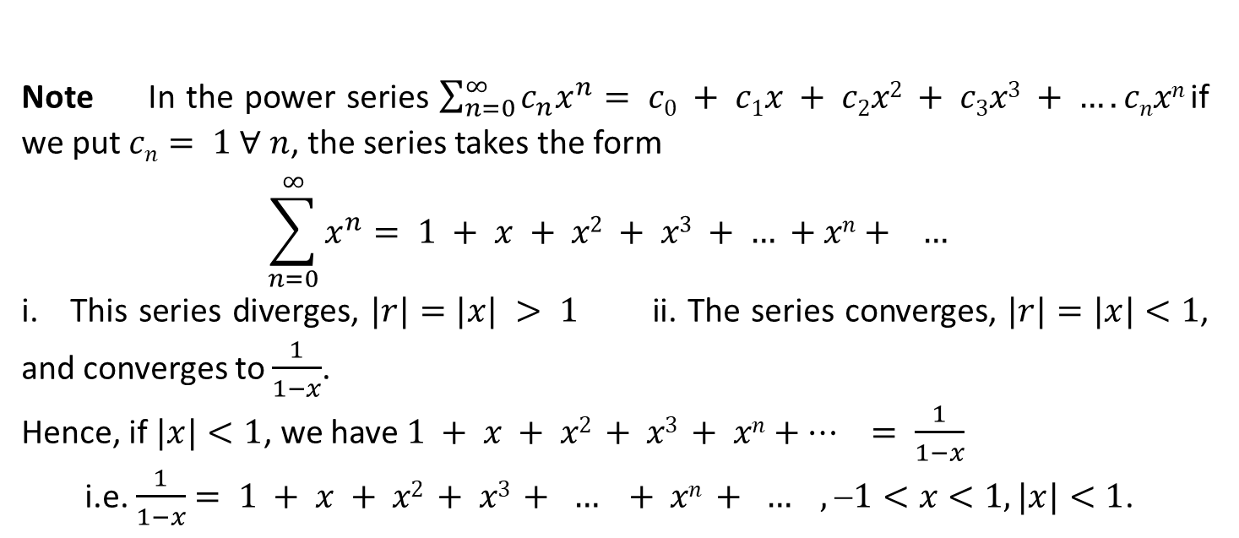
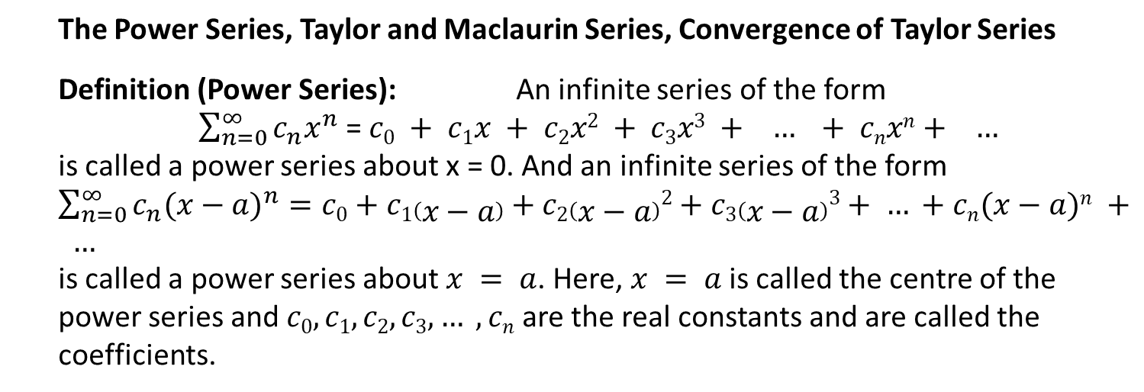
The Power Series, Taylor and Maclaurin Series, Convergence of Taylor Series
Definition (Power Series): An infinite series of the form
$\sum_{n=0}^{∞}{c_{n}x^{n}}$ = $c0 + c1x + c2x2 + c3x3 + … + cnxn+ …$
is called a power series about x = 0. And an infinite series of the form $\sum_{n=0}^{∞}{c_{n}{(x−a)}^{n}}=c0+c1\left(x−a\right)+c2\left(x−a\right)2+c3\left(x−a\right)3+ … +cn(x−a)n + …$
is called a power series about $x = a$. Here, $x = a$is called the centre of the power series and $c0, c1, c2, c3, … , cn$ are the real constants and are called the coefficients.
Note In the power series $\sum_{n=0}^{∞}{c_{n}x^{n}}$ $= c0 + c1x + c2x2 + c3x3 + …. cnxn$if we put $cn= 1 ∀ n$, the series takes the form
$$\sum_{n=0}^{∞}{x^{n}}= 1 + x + x2 + x3 + … +xn+ …$$ i. This series diverges, $|r|=|x| > 1$ ii. The series converges, $|r|=|x|<1$, and converges to $\frac{1}{1−x}$.
Hence, if $|x|<1$, we have $1 + x + x2 + x3 + xn+… = \frac{1}{1−x}$
i.e. $\frac{1}{1−x}$ $= 1 + x + x2 + x3 + … + xn + … , 1<x<1, |x|<1$.

Slide 2
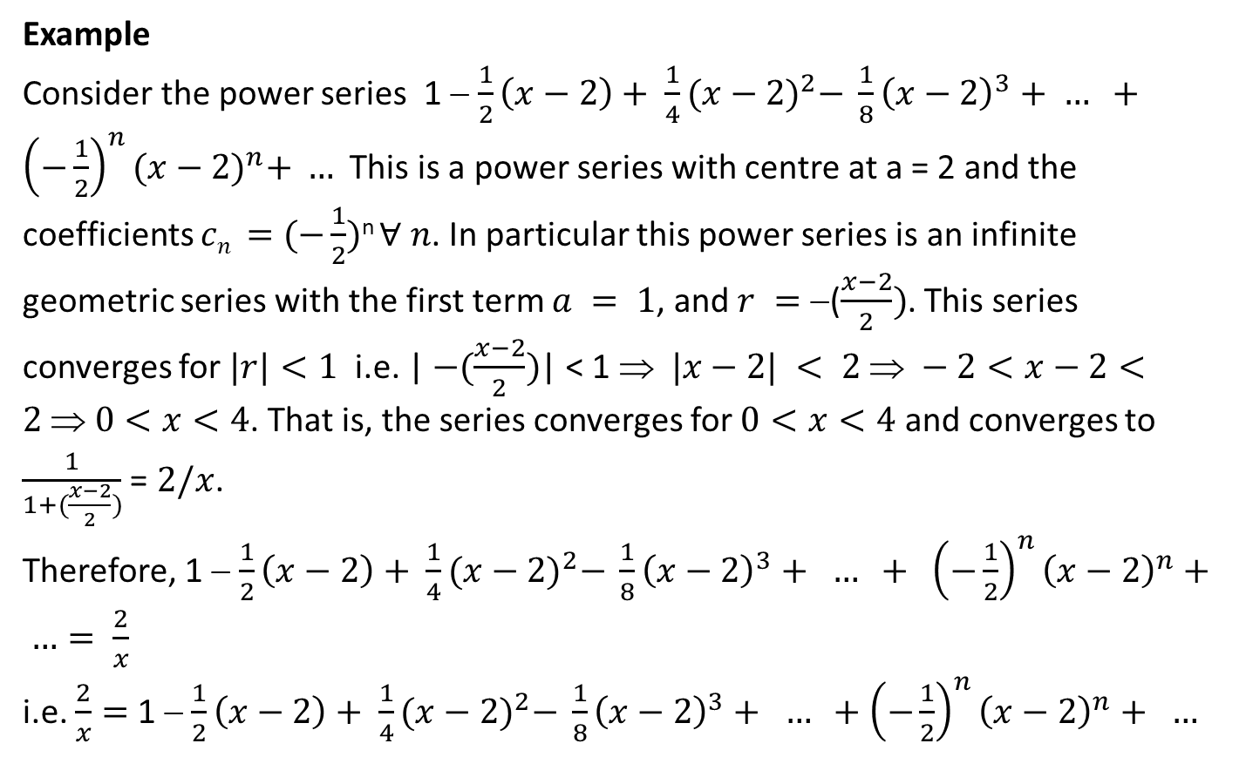
Example
Consider the power series 1 − $\frac{1}{2}\left(x−2\right)+ \frac{1}{4}{(x−2)}^{2}− \frac{1}{8}{\left(x−2\right)}^{3}+ … +{\left(−\frac{1}{2}\right)}^{n}{(x−2)}^{n}+ …$ This is a power series with centre at a = 2 and the coefficients $cn =$ $(−\frac{1}{2})$^{n} $∀ n$. In particular this power series is an infinite geometric series with the first term $a = 1$, and $r =$ −($\frac{x−2}{2})$. This series converges for $|r|<1$ i.e. | $−(\frac{x−2}{2})$| < 1 ⇒ $|x−2| < 2  −2<x−2<2$⇒$0<x<4$. That is, the series converges for $0<x<4$ and converges to $\frac{1}{1+(\frac{x−2}{2})}$ = $2/x$.
Therefore, 1 − $\frac{1}{2}\left(x−2\right)+ \frac{1}{4}{(x−2)}^{2}− \frac{1}{8}{\left(x−2\right)}^{3}+ … + {\left(−\frac{1}{2}\right)}^{n}{\left(x−2\right)}^{n}+ …= \frac{2}{x}$
i.e. $\frac{2}{x}=$1 − $\frac{1}{2}\left(x−2\right)+ \frac{1}{4}{(x−2)}^{2}− \frac{1}{8}{\left(x−2\right)}^{3}+ … +{\left(−\frac{1}{2}\right)}^{n}{\left(x−2\right)}^{n}+ …$

Slide 3
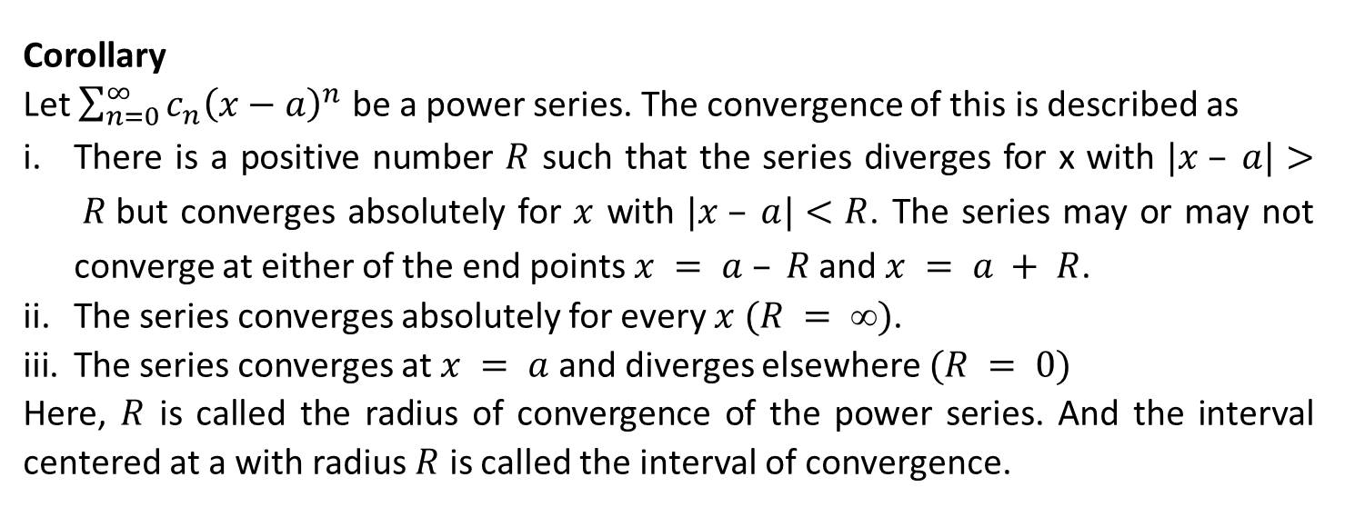

Convergence of Power Series
If the power series $\sum_{n=0}^{∞}{a_{n}x^{n}}$ converges for x = c ≠ 0, then it converges absolutely ∀ x s.t. |x|<|c|.
Next, if the series diverges for x = d, then it diverges ∀ x with |x|>|d|.
Corollary
Let $\sum_{n=0}^{∞}{c_{n}{\left(x−a\right)}^{n}}$ be a power series. The convergence of this is described as
There is a positive number $R$ such that the series diverges for x with $|x – a|> R$but converges absolutely for $x$ with $|x – a|<R$. The series may or may not converge at either of the end points $x = a – R$and $x = a + R$.
The series converges absolutely for every $x (R = )$.
The series converges at $x = a$ and diverges elsewhere $(R = 0)$
Here, $R$ is called the radius of convergence of the power series. And the interval centered at a with radius $R$ is called the interval of convergence.

Slide 4
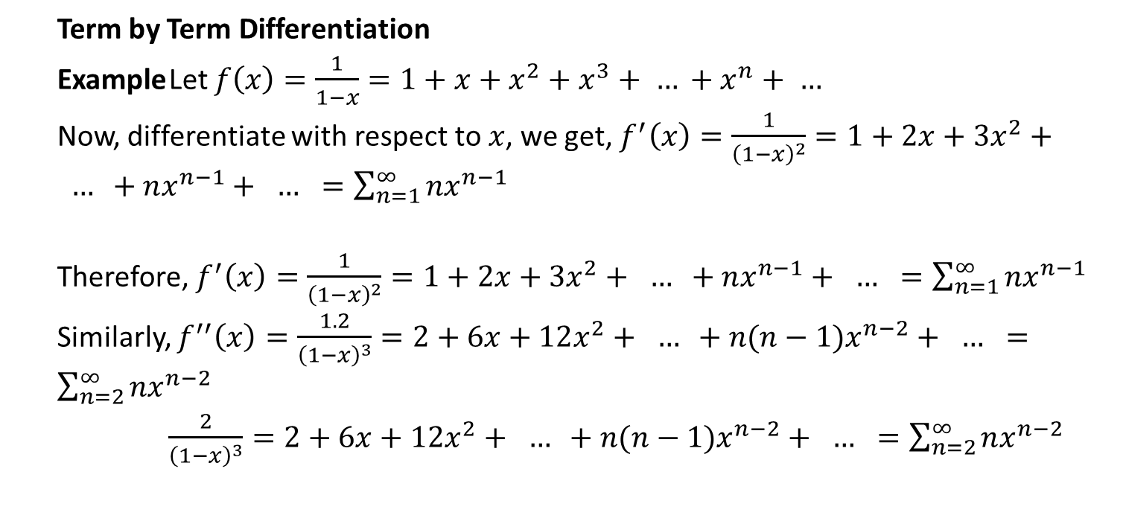
Term by Term Differentiation
Example Let $f\left(x\right)=\frac{1}{1−x}=1+x+x^{2}+x^{3}+ … +x^{n}+ …$
Now, differentiate with respect to $x$, we get, $f^{′}\left(x\right)=\frac{1}{{\left(1−x\right)}^{2}}=1+2x+3x^{2}+ … +nx^{n−1}+ … =\sum_{n=1}^{∞}{nx^{n−1}}$
Therefore, $f^{′}\left(x\right)=\frac{1}{{\left(1−x\right)}^{2}}=1+2x+3x^{2}+ … +nx^{n−1}+ … =\sum_{n=1}^{∞}{nx^{n−1}}$
Similarly, $f^{′′}\left(x\right)=\frac{1.2}{{\left(1−x\right)}^{3}}=2+6x+12x^{2}+ … +n(n−1)x^{n−2}+ … =\sum_{n=2}^{∞}{nx^{n−2}}$
$\frac{2}{{\left(1−x\right)}^{3}}=2+6x+12x^{2}+ … +n(n−1)x^{n−2}+ … =\sum_{n=2}^{∞}{nx^{n−2}}$

Slide 5
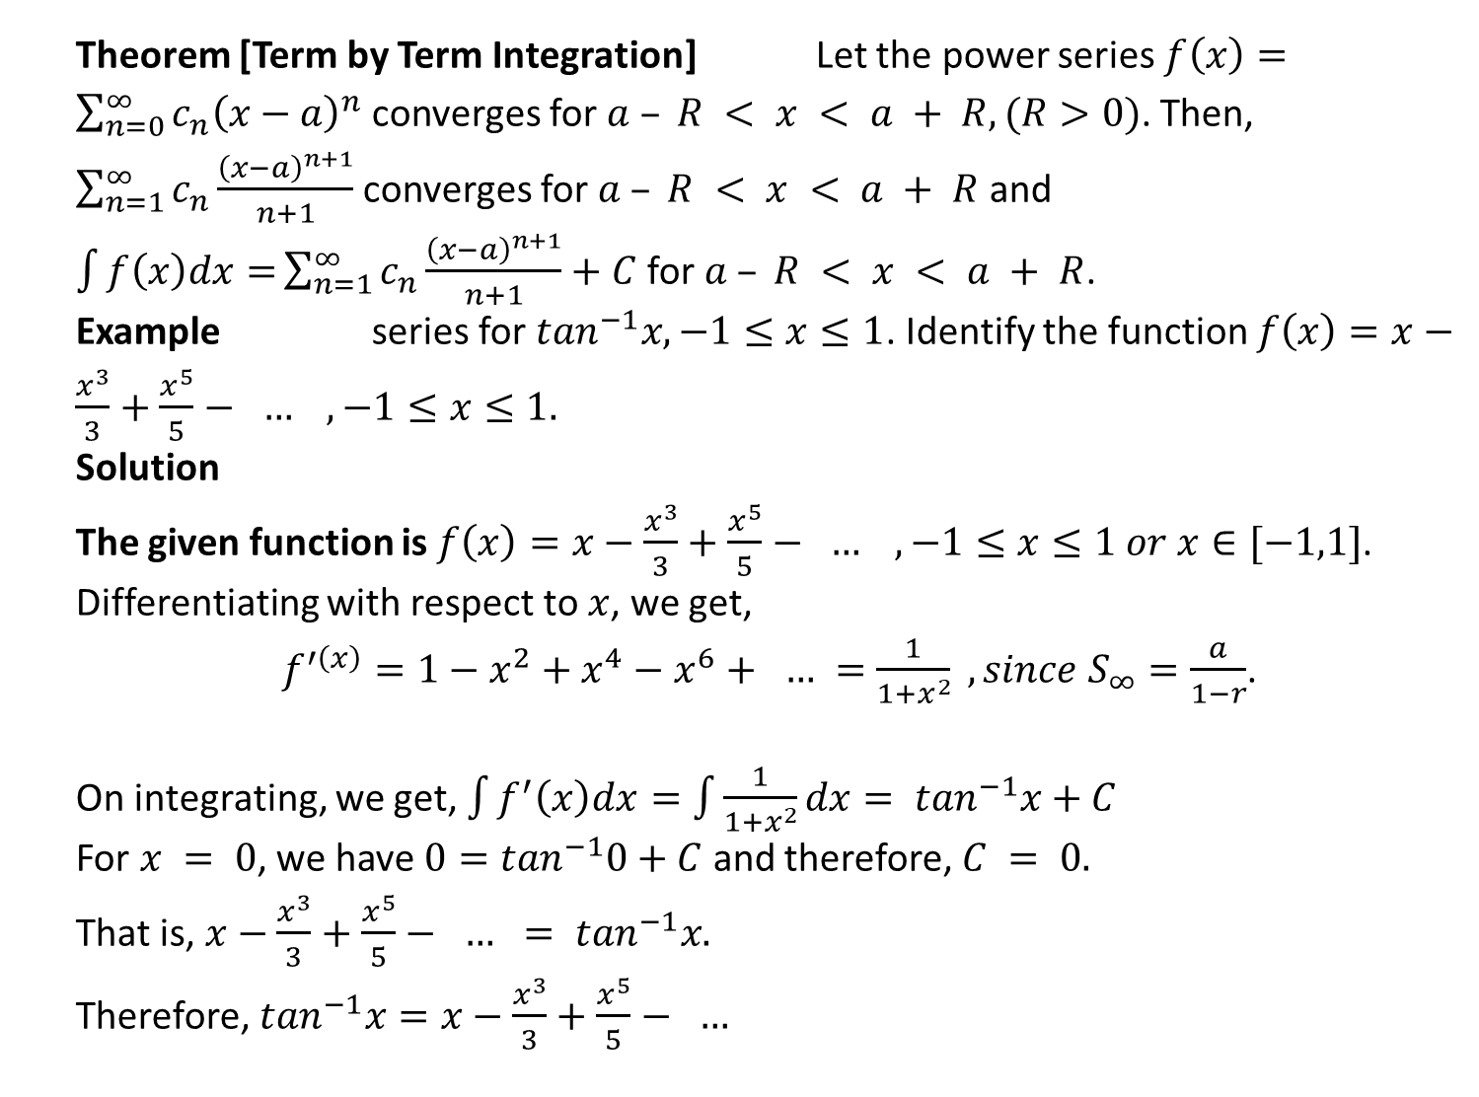
Theorem [Term by Term Integration] Let the power series $f\left(x\right)=\sum_{n=0}^{∞}{c_{n}{\left(x−a\right)}^{n}}$ converges for $a – R < x < a + R, (R>0)$. Then, $\sum_{n=1}^{∞}{c_{n}\frac{{\left(x−a\right)}^{n+1}}{n+1}}$ converges for $a – R < x < a + R$ and $\int{f\left(x\right)dx=}\sum_{n=1}^{∞}{c_{n}\frac{{\left(x−a\right)}^{n+1}}{n+1}}+C$ for $a – R < x < a + R$.
Example series for $\tan^{−1}x, −1≤x≤1$. Identify the function $f\left(x\right)=x−\frac{x^{3}}{3}+\frac{x^{5}}{5}− … , −1≤x≤1.$
Solution
The given function is $f\left(x\right)=x−\frac{x^{3}}{3}+\frac{x^{5}}{5}− … , −1≤x≤1 or x∈[−1,1]$.
Differentiating with respect to $x$, we get,
$f^{′\left(x\right)}=1−x^{2}+x^{4}−x^{6}+ … =\frac{1}{1+x^{2}} , since S_{∞}=\frac{a}{1−r}$.
On integrating, we get, $\int{f^{′}\left(x\right)dx=\int{\frac{1}{1+x^{2}}}dx}= \tan^{−1}x+C$
For $x = 0$, we have $0=\tan^{−1}0+C$ and therefore, $C = 0.$
That is, $x−\frac{x^{3}}{3}+\frac{x^{5}}{5}− … = \tan^{−1}x.$
Therefore, $\tan^{−1}x=x−\frac{x^{3}}{3}+\frac{x^{5}}{5}− …$

Slide 6
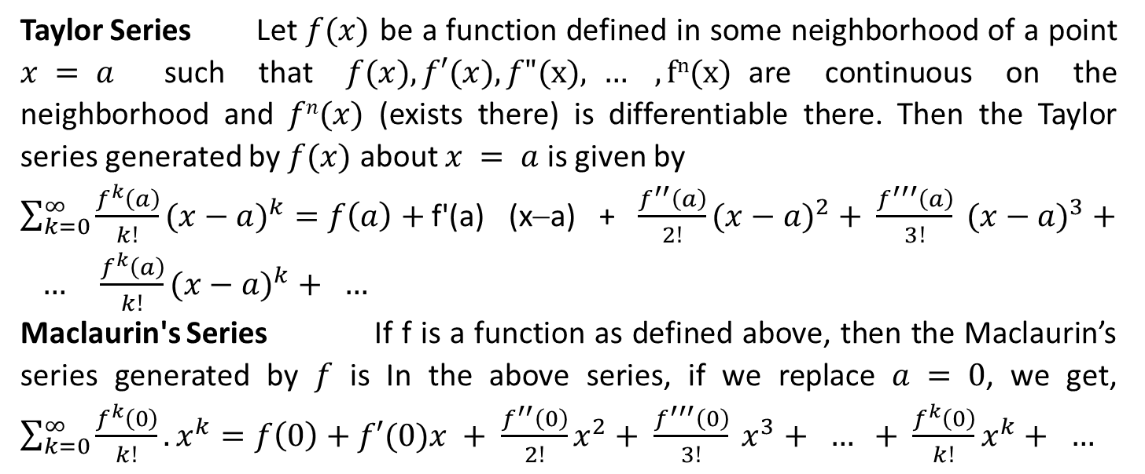
Taylor Series Let $f(x)$ be a function defined in some neighborhood of a point $x = a$ such that $f(x), f′(x), f"(x), … , fn(x)$are continuous on the neighborhood and $fn(x)$ (exists there) is differentiable there. Then the Taylor series generated by $f(x)$ about $x = a$ is given by
$\sum_{k=0}^{∞}{\frac{f^{k}\left(a\right)}{k!}{(x−a)}^{k}}=f\left(a\right)+$f'(a) (x−a) + $\frac{f^{′′}\left(a\right)}{2!}({x−a)}^{2}+ \frac{f^{′′′}\left(a\right)}{3!} ({x−a)}^{3}+ … \frac{f^{k}\left(a\right)}{k!}({x−a)}^{k}+ …$
Maclaurin's Series If f is a function as defined above, then the Maclaurin’s series generated by $f$ is In the above series, if we replace $a = 0$, we get, $\sum_{k=0}^{∞}{\frac{f^{k}\left(0\right)}{k!}.x^{k}}=f\left(0\right)+f′(0)x + \frac{f^{′′}\left(0\right)}{2!}x^{2}+ \frac{f^{′′′}\left(0\right)}{3!} x^{3}+ … + \frac{f^{k}\left(0\right)}{k!}x^{k}+ …$
Note The Maclaurin’s series of a function $f(x)$ is the Taylor’s series of $f(x)$ at $x = 0$ is known as Maclaurin's Series.

Slide 7
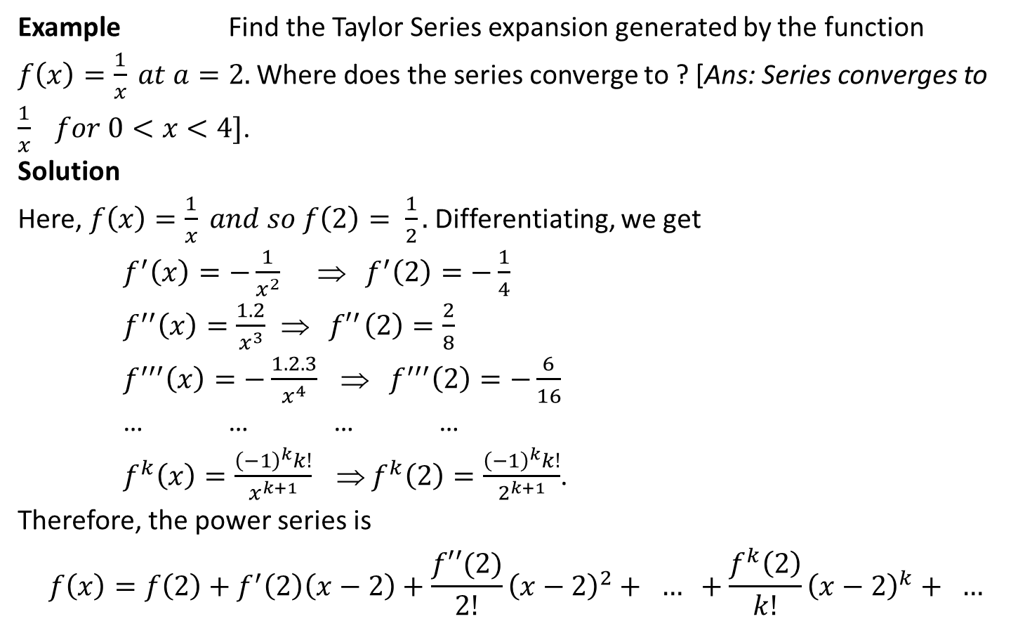
Example Find the Taylor Series expansion generated by the function $f\left(x\right)=\frac{1}{x} at a=2.$ Where does the series converge to ? [Ans: Series converges to $\frac{1}{x} for 0<x<4]$.
Solution
Here, $f\left(x\right)=\frac{1}{x} and so f\left(2\right)= \frac{1}{2}.$ Differentiating, we get
$f^{′}\left(x\right)=−\frac{1}{x^{2}} ⇒{ f}^{′}\left(2\right)=−\frac{1}{4}$
$f^{′′}\left(x\right)=\frac{1.2}{x^{3}}{ ⇒ f′}^{′}\left(2\right)=\frac{2}{8}$
$f^{′′′}\left(x\right)=−\frac{1.2.3}{x^{4}} {⇒ f}^{′′′}\left(2\right)=−\frac{6}{16}$
… … … …
$f^{k}\left(x\right)=\frac{{\left(−1\right)}^{k}k!}{x^{k+1}} ⇒ f^{k}\left(2\right)=\frac{{\left(−1\right)}^{k}k!}{2^{k+1}}$.
Therefore, the power series is
$$f\left(x\right)=f\left(2\right)+f^{′}\left(2\right)\left(x−2\right)+\frac{f′′(2)}{2!}{\left(x−2\right)}^{2}+ … +\frac{f^{k}\left(2\right)}{k!}{\left(x−2\right)}^{k}+ …$$

Slide 8
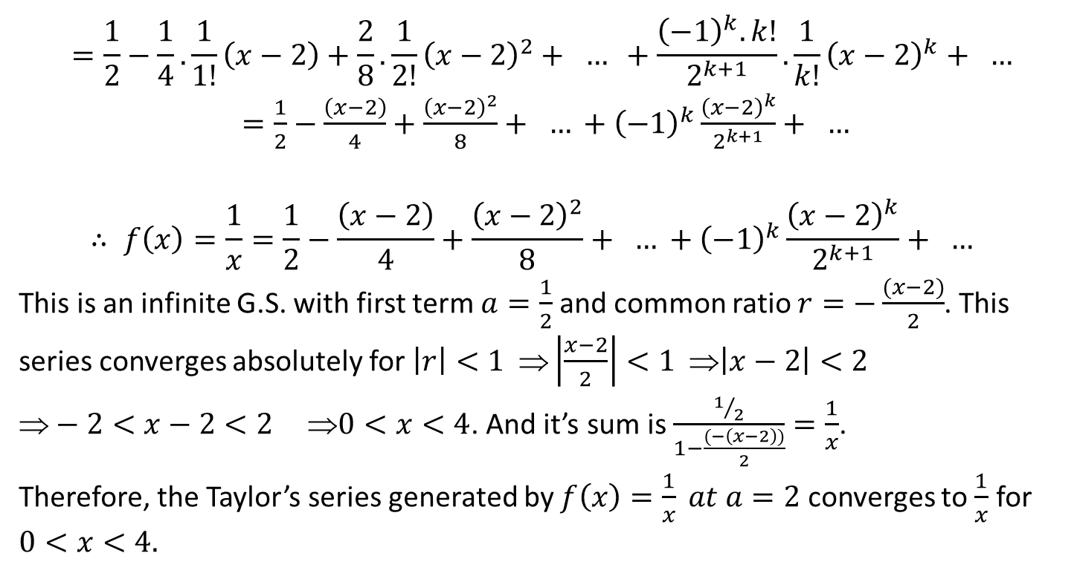
$$=\frac{1}{2}−\frac{1}{4}.\frac{1}{1!}\left(x−2\right)+\frac{2}{8}.\frac{1}{2!}{\left(x−2\right)}^{2}+ … +\frac{{\left(−1\right)}^{k}.k!}{2^{k+1}}.\frac{1}{k!}{\left(x−2\right)}^{k}+ …$$
$=\frac{1}{2}−\frac{\left(x−2\right)}{4}+\frac{{\left(x−2\right)}^{2}}{8}+ … +{\left(−1\right)}^{k}\frac{{\left(x−2\right)}^{k}}{2^{k+1}}+ …$
$$∴ f\left(x\right)=\frac{1}{x}=\frac{1}{2}−\frac{\left(x−2\right)}{4}+\frac{{\left(x−2\right)}^{2}}{8}+ … +{\left(−1\right)}^{k}\frac{{\left(x−2\right)}^{k}}{2^{k+1}}+ …$$
This is an infinite G.S. with first term $a=\frac{1}{2}$ and common ratio $r=−\frac{(x−2)}{2}$. This series converges absolutely for $\left|r\right|<1 ⇒\left|\frac{x−2}{2}\right|<1 ⇒\left|x−2\right|<2$
$−2<x−2<2 0<x<4$. And it’s sum is $\frac{1/2}{1−\frac{(−\left(x−2\right))}{2}}=\frac{1}{x}$.
Therefore, the Taylor’s series generated by $f\left(x\right)=\frac{1}{x} at a=2$ converges to $\frac{1}{x}$ for $0<x<4.$

Slide 9
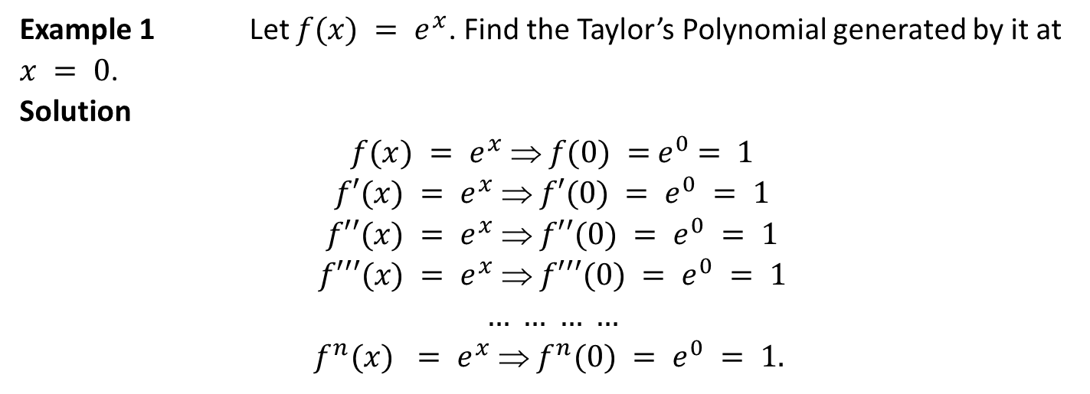
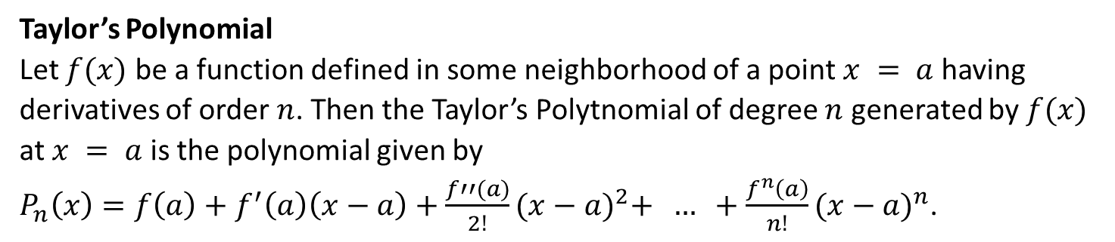
Taylor’s Polynomial
Let $f(x)$ be a function defined in some neighborhood of a point $x = a$ having derivatives of order $n$. Then the Taylor’s Polytnomial of degree $n$ generated by $f(x)$ at $x = a$ is the polynomial given by
$P_{n}\left(x\right)=f\left(a\right)+f^{′}\left(a\right)\left(x−a\right)+\frac{f′′(a)}{2!}{(x−a)}^{2}+ … +\frac{f^{n}\left(a\right)}{n!}{(x−a)}^{n}$.
Example 1 Let $f(x) = e^{x}$. Find the Taylor’s Polynomial generated by it at $x = 0$.
Solution
$$f(x) = e^{x}  f(0) ={ e}^{0} = 1$$
$$f′(x) = e^{x}  f′(0) = e^{0} = 1$$
$$f′′(x) = e^{x}  f′′(0) = e^{0} = 1$$
$$f′′′(x) = e^{x}  f′′′(0) = e^{0} = 1$$
$$… … … …$$
$$f^{n}(x) = e^{x}  f^{n}(0) = e^{0} = 1.$$

Slide 10
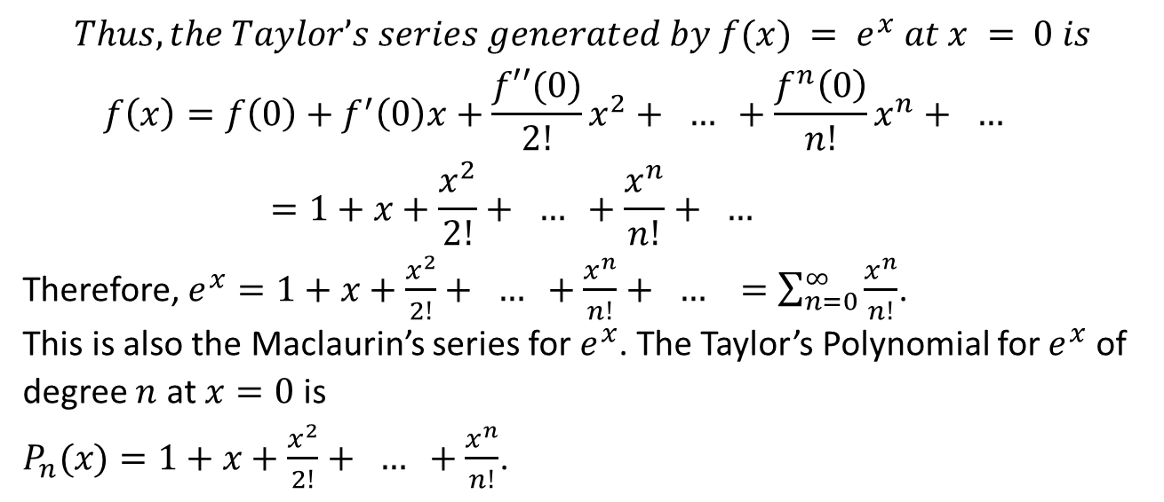
$$Thus, the Taylor’s series generated by f(x) = e^{x} at x = 0 is$$
$$f\left(x\right)=f\left(0\right)+f^{′}\left(0\right)x+\frac{f′′(0)}{2!}x^{2}+ … +\frac{f^{n}\left(0\right)}{n!}x^{n}+ …$$
$$=1+x+\frac{x^{2}}{2!}+ … +\frac{x^{n}}{n!}+ …$$
Therefore, $e^{x}=1+x+\frac{x^{2}}{2!}+ … +\frac{x^{n}}{n!}+ … =\sum_{n=0}^{∞}{\frac{x^{n}}{n!}}$.
This is also the Maclaurin’s series for $e^{x}$. The Taylor’s Polynomial for $e^{x}$ of degree $n$ at $x=0$ is
$P_{n}(x)=1+x+\frac{x^{2}}{2!}+ … +\frac{x^{n}}{n!}$.

Slide 11
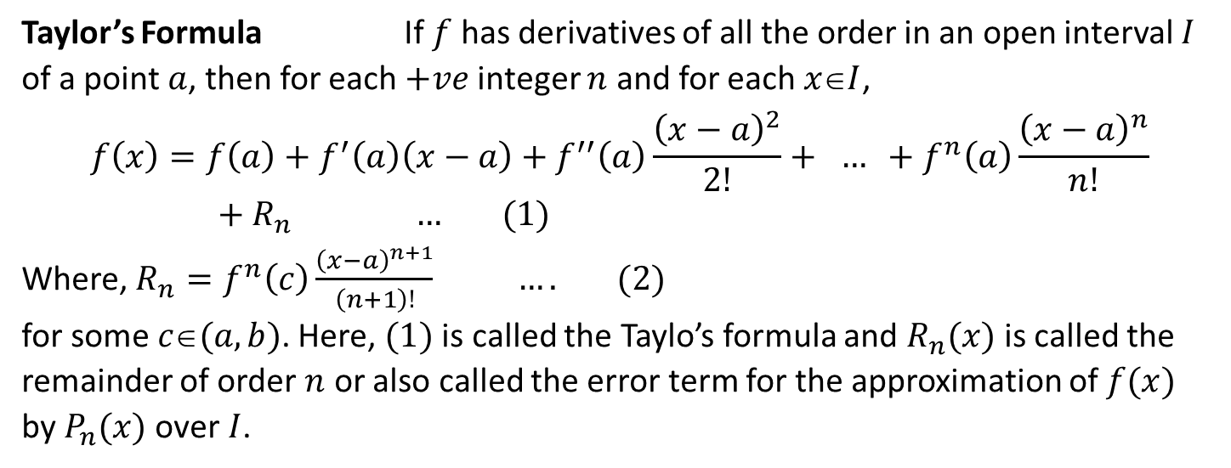
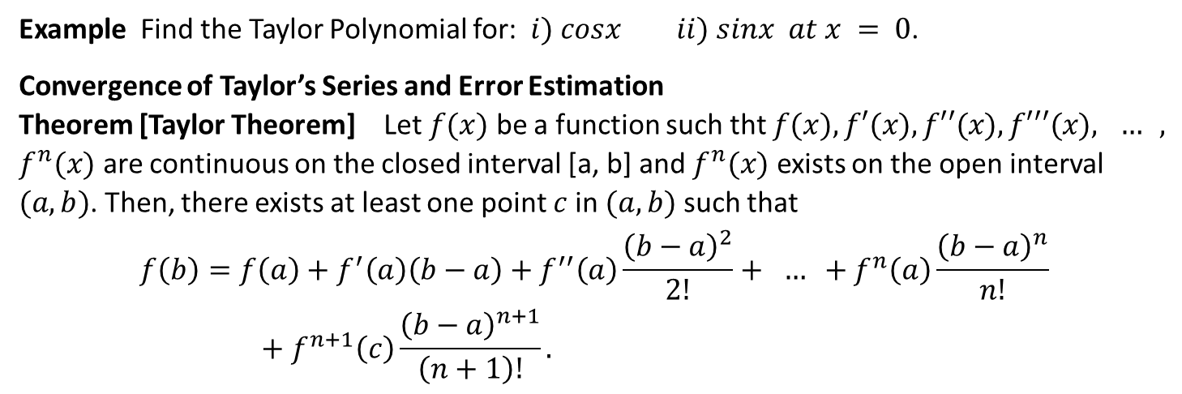
Example Find the Taylor Polynomial for: $i) cosx ii) sinx at x = 0$.
Convergence of Taylor’s Series and Error Estimation
Theorem [Taylor Theorem] Let $f(x)$ be a function such tht $f(x), f′(x), f′′(x), f′′′(x), … , f^{n}(x)$ are continuous on the closed interval [a, b] and $f^{n}(x)$ exists on the open interval $(a, b)$. Then, there exists at least one point $c$ in $(a, b)$ such that
$$f\left(b\right)=f\left(a\right)+f^{′}\left(a\right)\left(b−a\right)+f^{′′}\left(a\right)\frac{{\left(b−a\right)}^{2}}{2!}+ … +f^{n}\left(a\right)\frac{{\left(b−a\right)}^{n}}{n!}+f^{n+1}\left(c\right)\frac{{\left(b−a\right)}^{n+1}}{\left(n+1\right)!}.$$
Taylor’s Formula If $f$ has derivatives of all the order in an open interval $I$ of a point $a$, then for each $+ve$ integer $n$ and for each $xI$,
$$f\left(x\right)=f\left(a\right)+f^{′}\left(a\right)\left(x−a\right)+f^{′′}\left(a\right)\frac{{\left(x−a\right)}^{2}}{2!}+ … +f^{n}\left(a\right)\frac{{\left(x−a\right)}^{n}}{n!}+R_{n} … (1)$$
Where, $R_{n}=f^{n}\left(c\right)\frac{{\left(x−a\right)}^{n+1}}{\left(n+1\right)!} …. (2)$
for some $c(a, b)$. Here, $(1)$ is called the Taylo’s formula and $R_{n}(x)$ is called the remainder of order $n$ or also called the error term for the approximation of $f(x)$ by $P_{n}(x)$ over$I$.

Slide 12
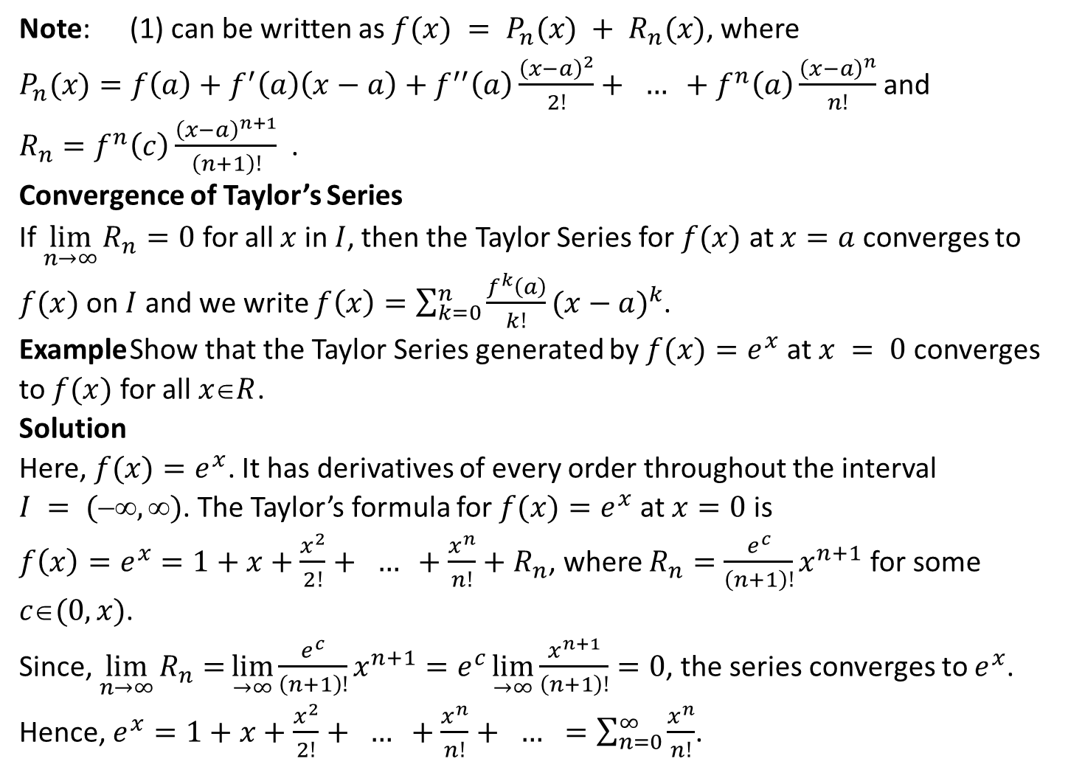
Note: (1) can be written as $f(x) = P_{n}(x) + R_{n}(x)$, where
$P_{n}(x)=f\left(a\right)+f^{′}\left(a\right)\left(x−a\right)+f^{′′}\left(a\right)\frac{{\left(x−a\right)}^{2}}{2!}+ … +f^{n}\left(a\right)\frac{{\left(x−a\right)}^{n}}{n!}$ and
$R_{n}=f^{n}\left(c\right)\frac{{\left(x−a\right)}^{n+1}}{\left(n+1\right)!}$.
Convergence of Taylor’s Series
If $\lim_{n→∞}{R_{n}=0}$ for all $x$ in $I$, then the Taylor Series for $f(x)$ at $x=a$ converges to $f(x)$ on $I$ and we write $f\left(x\right)=\sum_{k=0}^{n}{\frac{f^{k}\left(a\right)}{k!}{(x−a)}^{k}}$.
Example Show that the Taylor Series generated by $f(x)=e^{x}$ at $x = 0$ converges to $f(x)$ for all $xR$.
Solution
Here, $f(x)=e^{x}$. It has derivatives of every order throughout the interval $I = (, )$. The Taylor’s formula for $f(x)=e^{x}$ at $x=0$ is
$f\left(x\right)=e^{x}=1+x+\frac{x^{2}}{2!}+ … +\frac{x^{n}}{n!}+R_{n}$, where $R_{n}=\frac{e^{c}}{\left(n+1\right)!}x^{n+1}$ for some $c(0,x)$.
Since, $\lim_{n→∞}{R_{n}=}\lim_{→∞}{\frac{e^{c}}{\left(n+1\right)!}x^{n+1}}=e^{c}\lim_{→∞}{\frac{x^{n+1}}{\left(n+1\right)!}}=0$, the series converges to $e^{x}$.
Hence, $e^{x}=1+x+\frac{x^{2}}{2!}+ … +\frac{x^{n}}{n!}+ … =\sum_{n=0}^{∞}{\frac{x^{n}}{n!}}$.

Slide 13
The End

